Slide 1


الفسحة
• Maram Alserhani
• ID:2300681
• Dr :Ines Boufateh
• Data Visualization: Course Project

Slide 2

Project Introduction
Overview
In the ever-evolving landscape of media and entertainment, understanding the performance and dynamics of broadcast channels is crucial for stakeholders in the industry. This project aims to provide a comprehensive analysis of broadcast channel data through the development of an interactive dashboard. The dashboard will serve as a centralized platform for visualizing key metrics, trends, and insights derived from the dataset.

Slide 3

Objectives
Data Exploration: Dive into the dataset to uncover patterns, correlations, and anomalies related to broadcast channel performance.
Audience Insights: Gain a deeper understanding of the audience demographics, viewership patterns, and preferences.
Content Analysis: Evaluate the impact of different content types on viewership and engagement.
Temporal Trends: Analyze the temporal trends, including peak viewing times, seasonal variations, and any notable events affecting viewership.
Interactive Visualization: Build a user-friendly dashboard that allows stakeholders to interactively explore and analyze the data.

Slide 4
Goal
We will try to answer the following Questions:
What is Top 10 Episode Downloads ?
What is Top 5 APP used by User ?
What is Downloads Episode Last (All time,90 Days,30Days,7Days)?
What is Sum of Downloads by Country (I need Map and sum of country’s)?
What is Downloads By “Month” Through Four year ?
What is Downloads By “Year” And Forecasting it for 4 years above ?
What is Top 5 Country listen ?
What is percentage of Episode published ?
what is percentage of Continent ?

Slide 5
Dataset Details
Subject : Broadcast Channel Analysis Dashboard
Date from 2020 to 2023
Source: https://www.buzzsprout.com/1962886/13187453-

Slide 6

Dataset Overview
CSV File: stats_agent_report.csv
Podcast App: Indicates the name or type of podcast application through which the podcast content is accessed or downloaded.
Downloads: Represents the number of downloads of podcast episodes through the specified podcast app.

Slide 7
Dataset Overview
CSV File: stats_locations_report.csv
City: Specifies the city of the download location.
State: Identifies the state or region of the download location.
Country: Denotes the country of the download location.
Continent: Represents the continent of the download location.
Downloads: Indicates the number of downloads from the specified location.

Slide 8

Dataset Overview
CSV File: stats_overview_report.csv
Episode Title: Refers to the title or name of a specific podcast episode.
Episode ID:Provides a unique identifier for each podcast episode.
Publish Date:Signifies the date on which the podcast episode was published or made available for download.
Publish Status:Describes the current status of the podcast episode active or not.
Last 7 Days:Represents the number of downloads the episode has received in the last 7 days.
Last 30 Days: Indicates the number of downloads the episode has received in the last 30 days.
Last 90 Days: : Denotes the number of downloads the episode has received in the last 90 days.
All Time Downloads: Represents the total number of downloads for the episode since its publication.

Slide 9

Data preparation
1.Data Cleaning: We will start by cleaning the
dataset, addressing any missing or erroneous
entries but my data it cleaned .
2. Exploratory Data Analysis (EDA): Conduct a
thorough exploration of the data to identify
patterns, outliers, and trends.
3.Descriptive Statistics: Compute key statistical
measures to gain insights into the central
tendencies and distributions of the data.
4.Visualization: Utilize charts and graphs to visually
represent the findings and make the analysis
more accessible using power bi

Slide 10
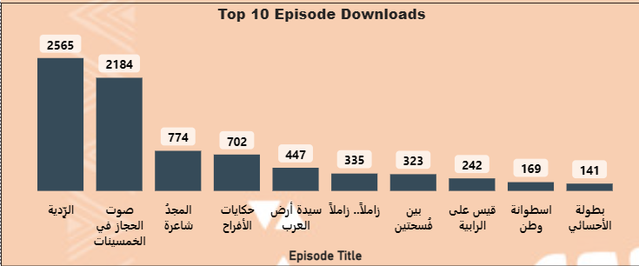
What is Top 10 Episode Downloads ?

Slide 11
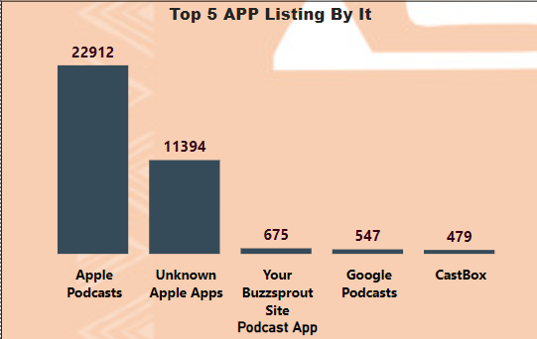
What is Top 5 APP used by User ?

Slide 12
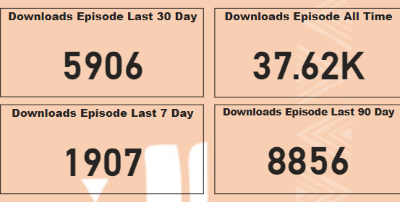
What is Downloads Episode Last (All time,90 Days,30Days,7Days)?

Slide 13
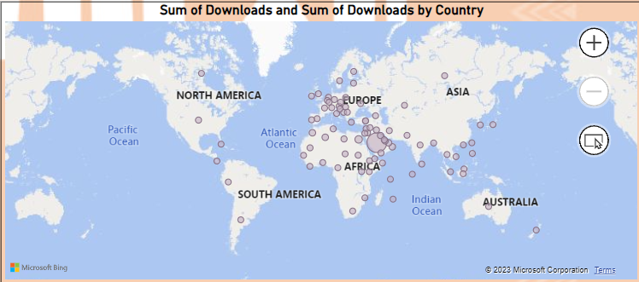
What is Sum of Downloads by Country (I need Map and sum of country’s)?

Slide 14
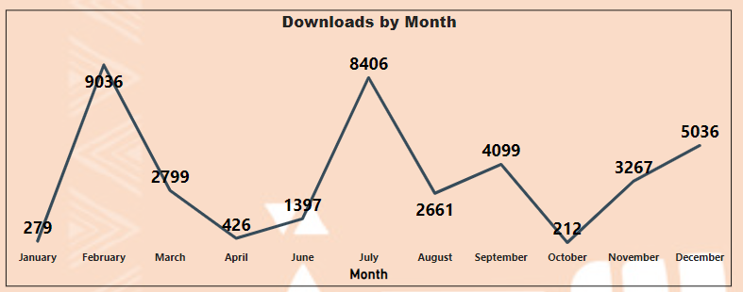
What is Downloads By “Month” Through Four year ?

Slide 15
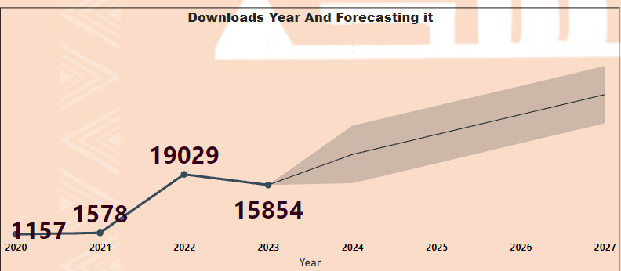
What is Downloads By “Year” And Forecasting it for 4 years above ?

Slide 16
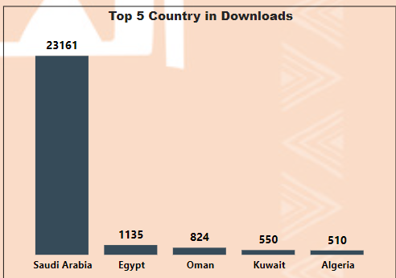
What is Top 5 Country listen ?

Slide 17
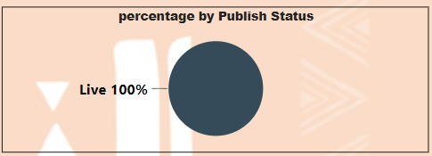
What is percentage of Episode published ?

Slide 18
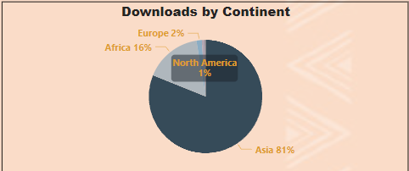
what is percentage of Continent ?

Slide 19
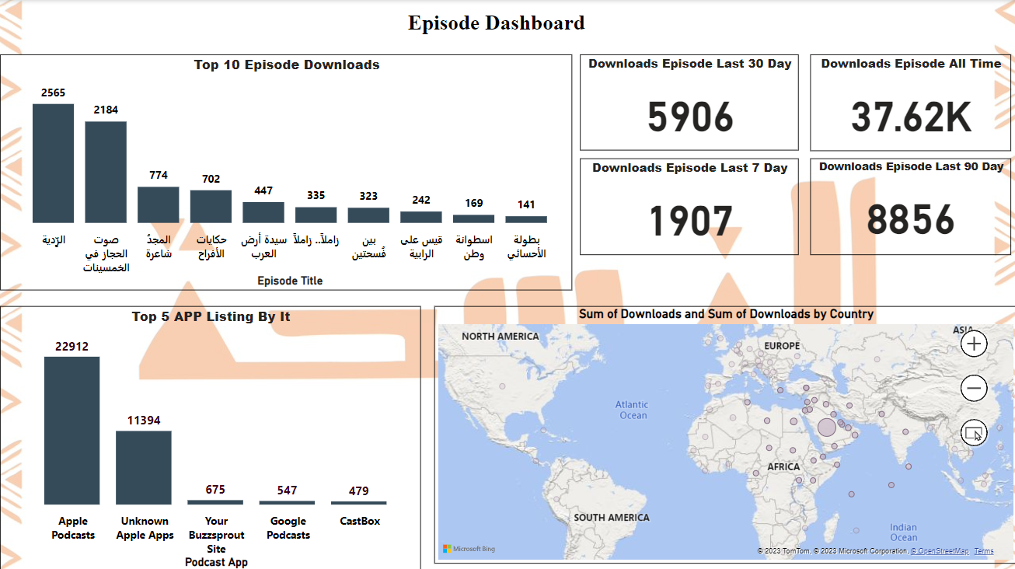
Dashboard

Slide 20
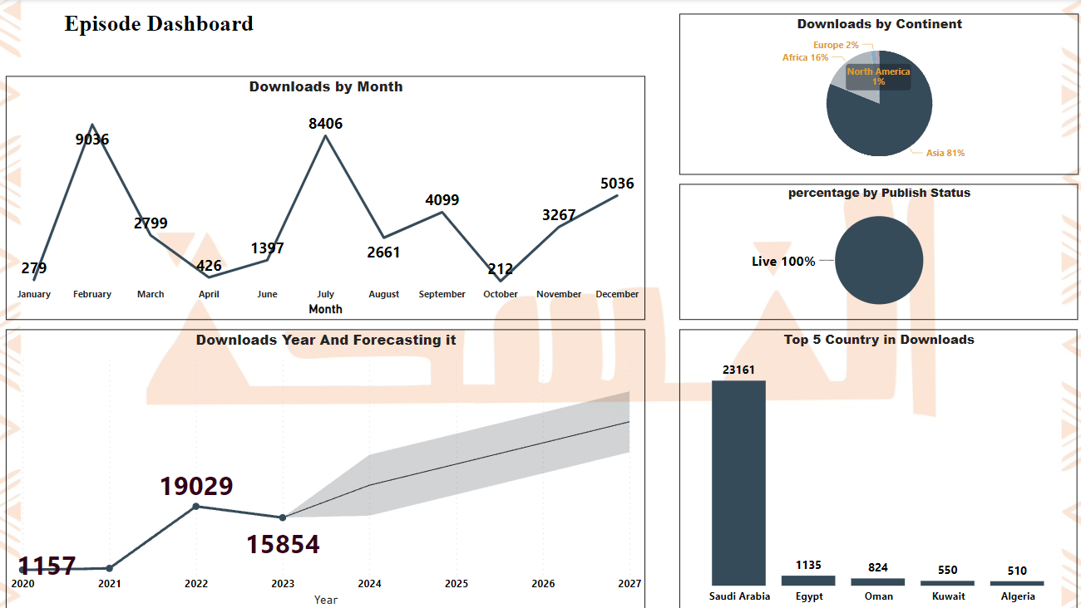
Dashboard

Slide 21

Conclusion
Top 4 Months for Downloads
>>February, July, September, December: These months stand out as peak periods for podcast downloads. Content creators and advertisers can capitalize on these months to maximize audience engagement and reach.
Highest Year
>>"2022": The data indicates that 2022 is the highest-performing year for podcast downloads. Content creators should take note of this trend when planning and promoting new content.
Forecasting Downloads for the Next 4 Years
>>"42824": Forecasting an estimated 42,824 downloads for the next four years. This projection can guide content planning and resource allocation for the upcoming years.
All Broadcasts Available on Website
>>"100%": Confirming that all broadcasts are available on the website provides a centralized platform for users, ensuring accessibility and convenience.

Slide 22

Conclusion
Geographic Distribution
Asia: With the majority of downloads in Asia (30,465), the focus should be on tailoring content to the preferences of the Arabic-speaking population in countries like Saudi Arabia and neighboring regions.
Africa: The significant number of downloads in Africa (6,122) highlights an existing interest in Arabic podcast content. Content creators can explore themes that resonate with African audiences.
Europe: Although Europe has a lower number of downloads (579), it still represents interest. Understanding the specific interests of European listeners can inform content creation strategies.
North America: A moderate number of downloads in North America (360) indicates the presence of Arabic-speaking audiences. Creators may explore topics that appeal to this demographic.
Australia and South America: With lower numbers of downloads in Australia (31) and South America (8), content creators may consider targeted strategies to increase visibility and engagement in these regions.
Top 10 Episodes
Episodes such as "الرِّدية," "صوت الحجاز في الخمسينات," "المجدُ شاعرة," and others have garnered significant downloads. Analyzing the success factors of these episodes can inform future content creation.

Slide 23

Conclusion
Top 5 Apps for Downloads:
>> The primary apps for downloads include Apple Podcasts, Unknown Apple Apps, Your Buzzsprout Site, Google Podcasts, and CastBox. Creators should optimize their content for these platforms to enhance accessibility.
Episode Download Statistics:
All Time: 37,618 downloads indicate sustained interest in the podcast content over time.
Last 7 Days: 1,907 downloads suggest recent engagement and ongoing interest.
Last 30 Days: 5,906 downloads reflect a consistent level of interest in the past month.
Last 90 Days: 8,856 downloads showcase a longer-term engagement trend.
Top 5 Countries for Downloads:
Saudi Arabia, Egypt, Oman, Kuwait, Algeria: These countries stand out as the top contributors to downloads. Creators can tailor content to align with the interests and preferences of audiences in these regions.

